Slide 1
Chromatic Calorimetry
- Ratul

Slide 2
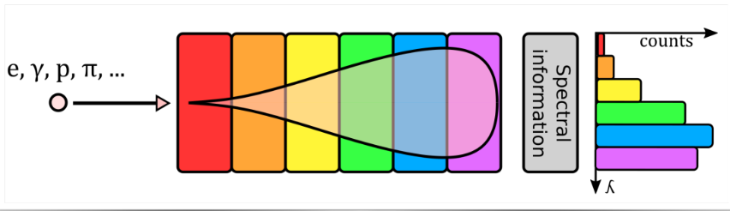
Basic Principle
concept: The concept involves strategically layering scintillators with various emission wavelengths.
Those emitting the longest wavelengths are positioned at the beginning and the shortest wavelengths are placed towards the end of the module.
We try to simulate a stack of different inorganic bulk scintillators with different emission spectra strategically positioned in decreasing wavelength maxima, to enable one-directional transparency as per chromatic calorimetry requirement.
Devanshi Arora, CERN & Shizuoka University, Japan, CALOR 2024

Slide 3
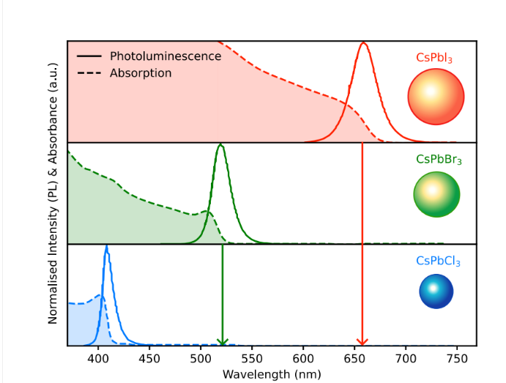
Leftmost scint. material : absorb wavelengths < 650 nm emit at > 680 nm next band : absorb wavelengths < 590 nm emit at > 590 nm Rightmost scint. material : absorb wavelengths < 410 nm emit at > 420 nm
Y. Haddad, N U, Boston, USA (based on data from: Zheng, W. et al, Nat Commun 9, 3462 (2018))

Slide 4
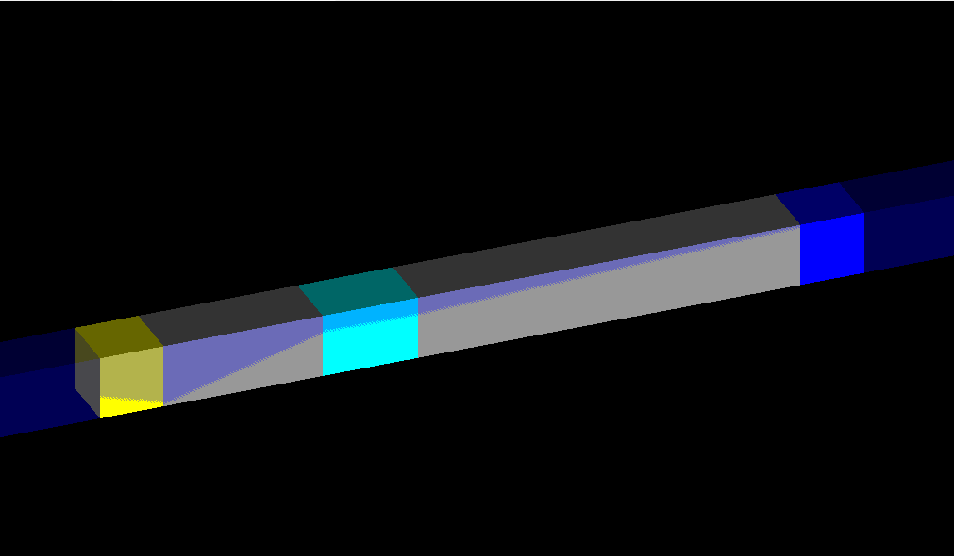
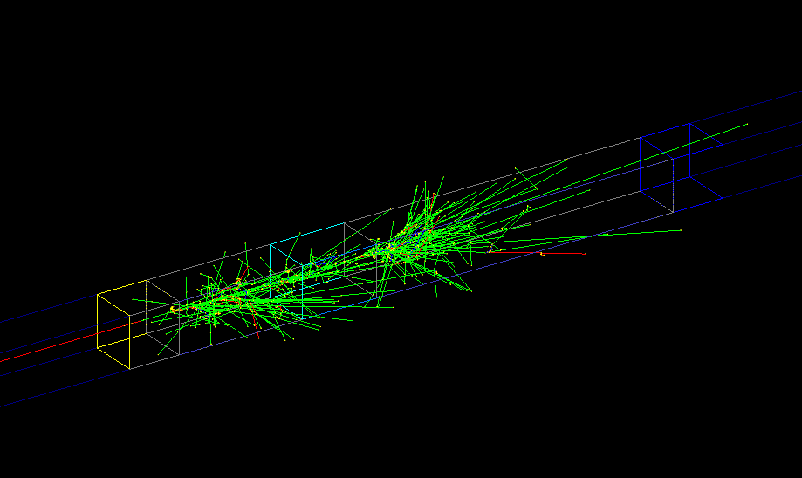
CHROMATIC CALORIMETRY: SIMULATION
The crystal stack was constructed using the following inorganic
Scintillators:
gadolinium aluminum gallium garnet (GAGG), 2x2x2 cm, peak emission – 540 nm, Yellow
2x2x5 cm and 2x2x12 cm lead tungstate (PWO), peak emission – 420 nm, Gray
bismuth germanate (BGO), 2x2x3 cm,
peak emission – 480 nm, Cyan
lutetium yttrium oxy orthosilicate (LYSO), 2x2x2 cm,
peak emission – 420 nm, Blue.
Total length of stack = 24 cm
https://github.com/dyn-warrior/Chroma.Calo---Geant4/blob/main/MyDetectorConstruction.cc
Incoming
e-
From collaboration with Lakshya Chauhan

Slide 5
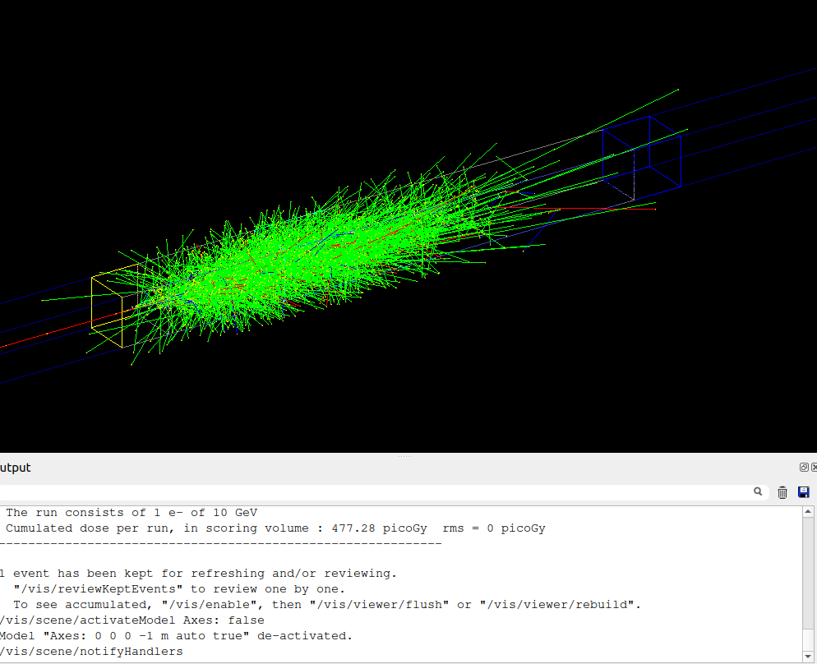
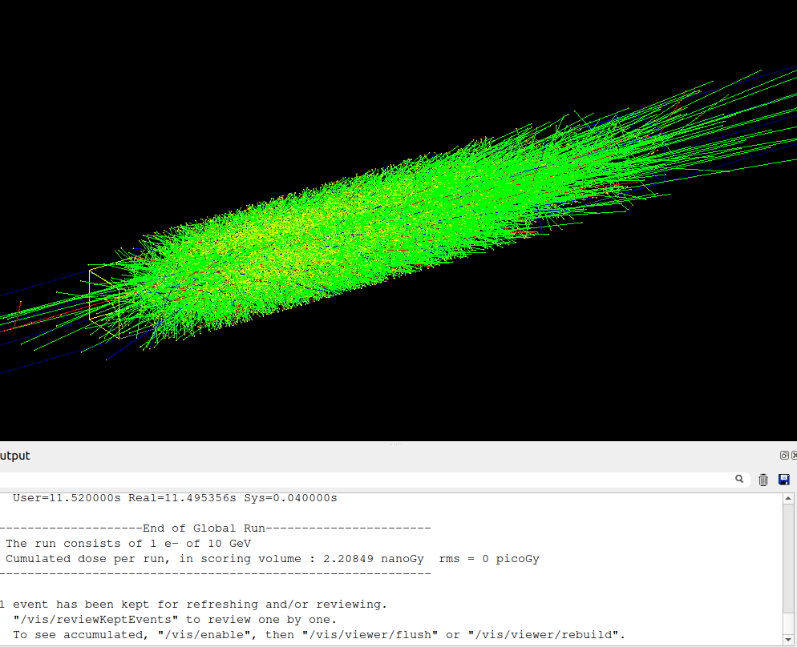
Running Test Beam
Running 10 GeV electron.
Count 1
Running 10 GeV electrons. Count 10

Slide 6
Energy Deposition Tracking
Geant4 tracks particles in discrete steps as they traverse the detector. Each step is defined by:
PreStepPoint: The particle's state at the beginning of the step.
PostStepPoint: The particle's state at the end of the step.
For each step within a sensitive volume:
The energy deposited during the step was calculated using G4double edep = step->GetTotalEnergyDeposit();
The volume in which the energy deposition occurred was identified using GetTouchableHandle().
Energy Summation:
Energy from individual steps was accumulated for each layer using the following procedure:
Each step within a layer contributed to the layer’s total energy deposition.
The accumulated energy for each layer was recorded at the end of each event.
Energy accumulation of all the layers was summed up to give total energy deposit of the whole detector.

Slide 7
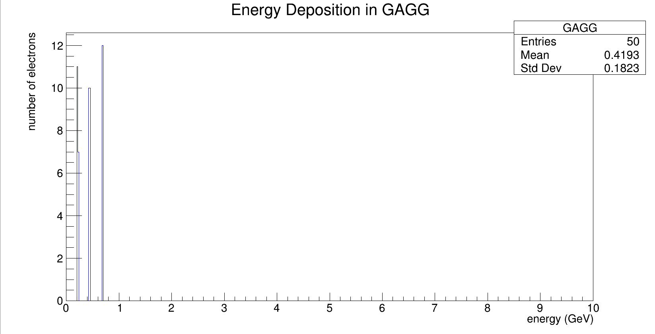
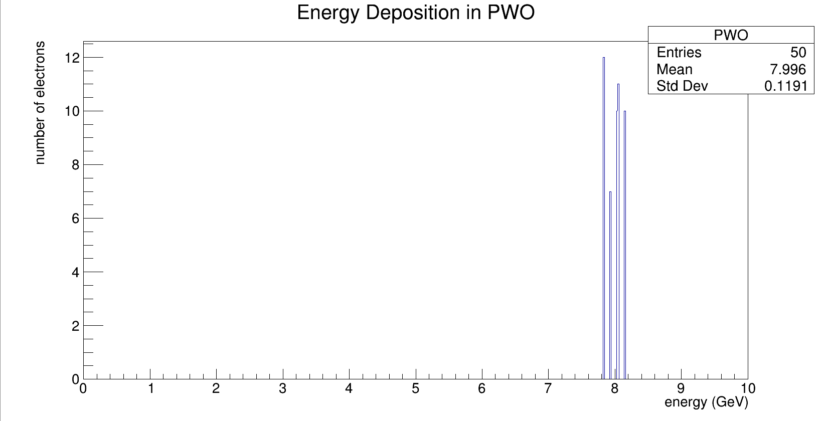
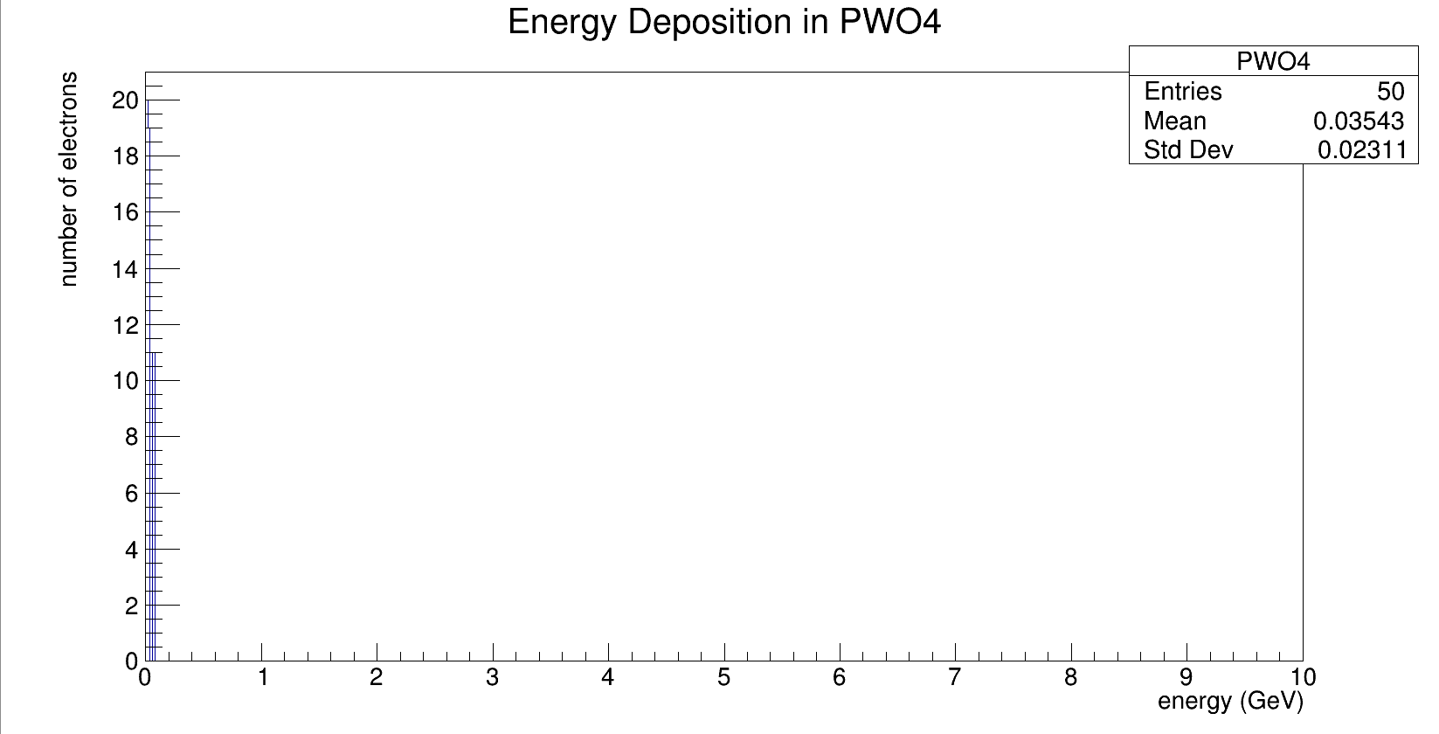
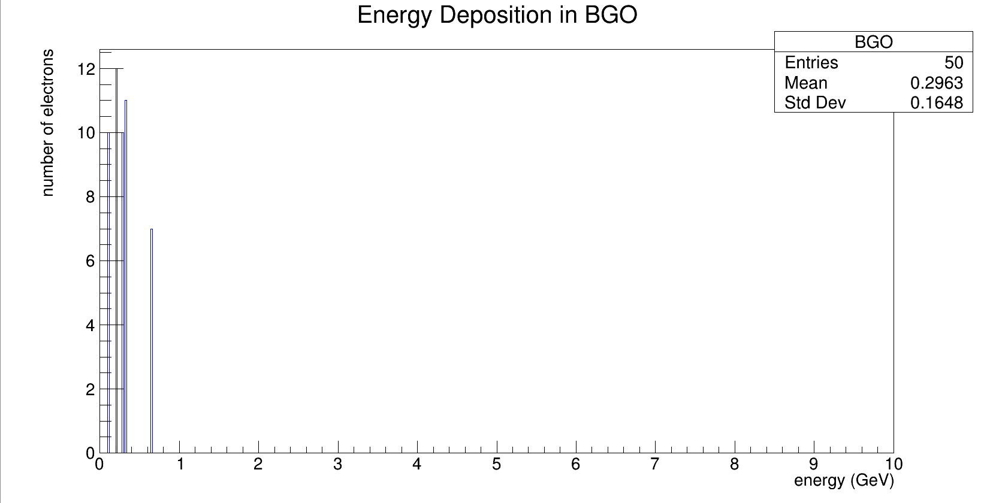
Results:

Slide 8
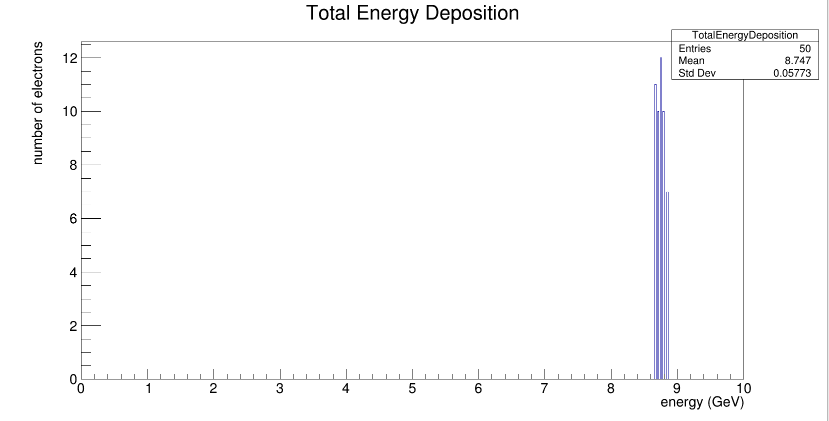

Slide 9
References:
geant4/examples/basic/B3/B3b
https://arxiv.org/pdf/2411.03685v1
Calo_Conf_2024JP----23_5_2024.pdf

Slide 10
THANK YOU

